Slide 1
Convolutional Neural Networks for sentence classification
Paper presentation by: Aradhya Chouhan

Slide 2
Author
Yoon Kim : New York University

Slide 3
introduction
Deep learning models have achieved remarkable results in computer vision (Krizhevsky et al., 2012) and speech recognition (Graves et al., 2013) in recent years
Originally invented for computer vision, CNN models have subsequently been shown to be effective for NLP and have achieved excellent results in semantic parsing (Yih et al., 2014), search query retrieval (Shen et al., 2014), sentence modeling (Kalchbrenner et al., 2014), and other traditional NLP tasks (Collobert et al., 2011).

Slide 4
objective
In the present work, we train a simple CNN with one layer of convolution on top of word vectors obtained from an unsupervised neural language model.

Slide 5
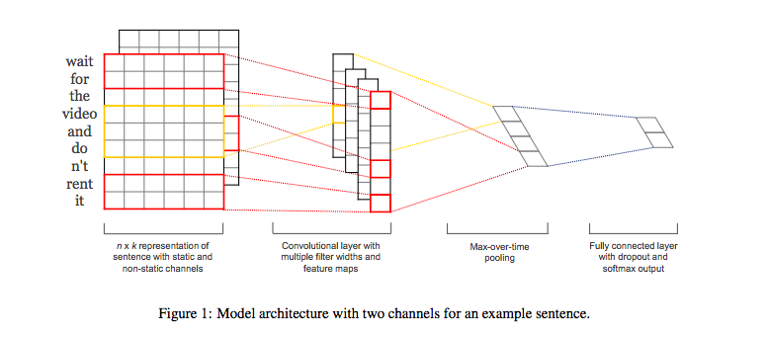
Model Architecture

Slide 6
Model: data representation
Let xi ∈ R k be the k-dimensional word vector corresponding to the i-th word in the sentence.
A sentence of length n (padded where necessary) is represented as x1:n = x1 ⊕ x2 ⊕ . . . ⊕ xn, (1) where ⊕ is the concatenation operator.
In general, let xi:i+j refer to the concatenation of words xi , xi+1, . . . , xi+j .
A convolution operation involves a filter w ∈ R dim hk.

Slide 7
Model: convolution
A feature ci is generated from a window of words xi:i+h−1 by ci = f(w · xi:i+h−1 + b). (2)
Here b ∈ R is a bias term and f is a nonlinear function such as the hyperbolic tangent. This filter is applied to each possible window of words in the sentence
{x1:h, x2:h+1, . . . , xn−h+1:n} to produce a feature map
c = [c1, c2, . . . , cn−h+1], (3) with c ∈ R dim n−h+1.

Slide 8
Model: max pooling
We then apply a max-overtime pooling operation (Collobert et al., 2011) over the feature map and take the maximum value cˆ = max{c} as the feature corresponding to this particular filter.

Slide 9
Regularization: dropout
For regularization we employ dropout on the penultimate layer with a constraint on l2-norms of the weight vectors (Hinton et al., 2012).
Dropout prevents co-adaptation of hidden units by randomly dropping out—i.e., setting to zero—a proportion p of the hidden units during forward-backpropagation.

Slide 10
Regularization: dropout
Given the penultimate layer z = [ˆc1, . . . , cˆm] (note that here we have m filters), instead of using
y = w · z + b (4)
for output unit y in forward propagation, dropout uses
y = w · (z ◦ r) + b, (5)
where ◦ is the element-wise multiplication operator and r ∈ R m is a ‘masking’ vector of Bernoulli random variables with probability p of being 1.

Slide 11
Hyperparameters
Final values used in the Convolutional network →

Slide 12
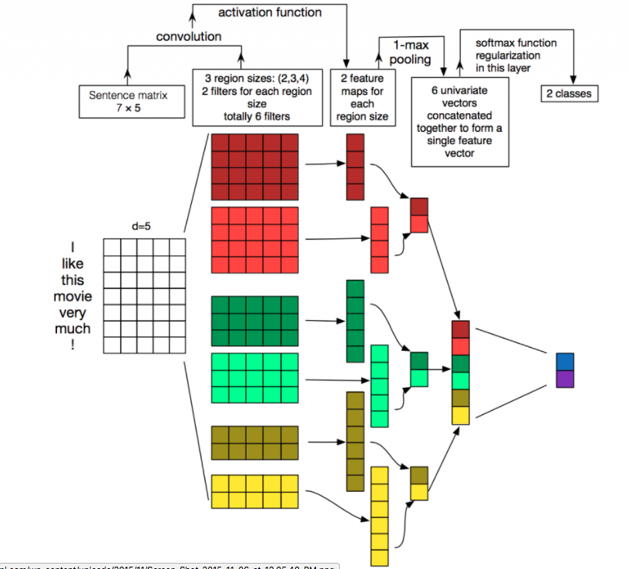

Slide 13
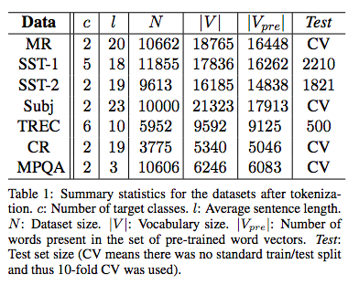
Datasets for testing the model
• MR: Movie reviews with one sentence per review.
• SST-1: Stanford Sentiment Treebank.
• SST-2: Same as SST-1 but with neutral reviews removed.
• Subj: Subjectivity dataset.
• TREC: TREC question dataset—task.
• CR: Customer reviews of various products.

Slide 14
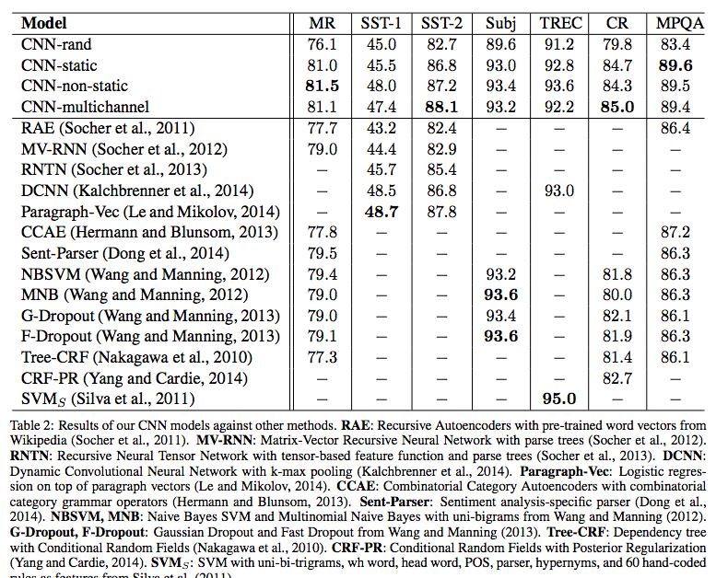
Results
These results suggest that the pretrained vectors are good, ‘universal’ feature extractors and can be utilized across datasets. Fine tuning the pre-trained vectors for each task gives still further improvements (CNN-non-static).

Slide 15
conclusion
The present work has described a series of experiments with convolutional neural networks built on top of word2vec. Despite little tuning of hyperparameters, a simple CNN with one layer of convolution performs remarkably well. Our results add to the well-established evidence that unsupervised pre-training of word vectors is an important ingredient in deep learning for NLP.

